Slide 1

SLIDE 1
Peripheral Plutarch
2. Hariharan V-96770 01745, Thinesh V-9488075352
3. Open Innovation
4. IOT BASED END TO END MONITORING IN FACTION GRID
Notes:
0

Slide 2
SLIDE 2
Abstract:
Planning to revamp the existing central grid system which requires very high investment and alternative power distribution to act in the place at the time of replacement is beyond the scope; instead it is possible to bring intelligent way of strengthening community based grid system to be aligned with central grid; which may not require the replacement of entire and to be carried out through minimum investment.

Slide 3
SLIDE 3
Novelty & Existing Solution:
End to end distribution monitoring of uninterrupted power through Faction grid for communal needs.The present power grid consists of central power system, High Voltage, Transmission systems which is too old exists and with which 70% of the total energy is distributed throughout the cities. Replacing the existing with new components is nearly impossible so we can just provide a supplementary grid and help the central power system withstand heavy loads. Even after some years, the central will breakdown due to increasing power demand.so instead of updating the whole central grid we can upgrade the supplementary grid so that the central grid will stay healthy. Surprisingly in future the household usage and industrial load will be reduced. So, we need to consider the durability of the load. The current doesn't have any end-to-end monitoring platform to recognize or organize the electricity data and there is no way to contribute some amount of energy even though we are equipped with a renewable resource.

Slide 4
SLIDE 4
TECHNOLOGY STACK
Software:
1. JAVA - For app development
2. Firebase - For Database & Authentication
3. Flask - For Website
Hardware :
1. Particle photon - MCU
2. Raspberry pi & pico - Realtime Data Monitoring
3. Solid State Relay assembly - For switch & impedance Matching

Slide 5
SLIDE 5

Slide 6
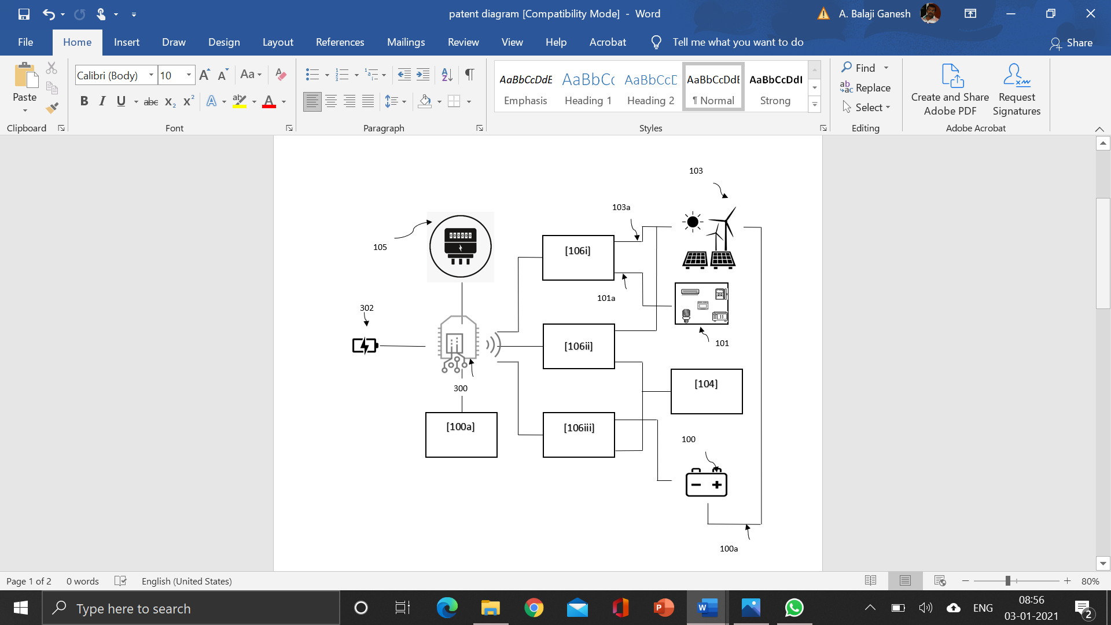
SLIDE 5

Slide 7
SLIDE 6
Business model
1. The Faction Grid is long term project which requires the private authority to sign NDA inorder to govern or access the entire grid.The First world has already signed a NDA with private comapnies. For example, States signed a NDA with apple to access their solar unit during the lockdown period. The next step is to deliver a alpha model into the urban areas. Alpha model will be Faction Ready but will not be connected to faction grid unless it crosses the thershold. After reaching a profitable amount of excess current the alpha model(photon powered module) will be connected to faction grid. From there, the billing will start and the faction points will be sent to their account(kinda like crypto mining). The renewable energy sources which is connected to the alpha models will power-up the whole faction grid. For every time out the collected faction points will be sent to the respective production end account.

Slide 8
2. we have filled the patent for the idea which is proposed in this module and now we are waiting the startup India to recognize our Startup. The details of the patent is listed below.
Application Number: 202141000156
Date of Filing: 04/01/2021
*Each and every model included in this module is form our patent*
our startup plays a major role in monitoring and managing the grid and its data. Both in the production and other end the data will be collected for billing and analytics.

